Slide 1

Supermarket Sales Analysis Project
An internship project presentation by Team A: Sheik & Bharani, presented on August 6.

Slide 2



Project Overview
Our objective was to analyze supermarket sales data, generate actionable insights, and forecast future trends. This comprehensive project leveraged a suite of powerful tools to ensure robust analysis and clear visualization.
Objective
Tools Used
Data Source
Analyze supermarket sales data to generate insights and forecast trends.
Excel, Python, SQL, Power BI, GitHub
Supermart Grocery Sales Dataset

Slide 3

Team Roles & Responsibilities
Sheik
Bharani
Excel Data Cleaning
Excel Cleaning File
Power BI Dashboard Design
Python Forecasting Model
GitHub Repository Management
Power BI Slicer Integration

Slide 4

Exploratory Data Analysis (EDA)
Our Exploratory Data Analysis (EDA) process was crucial for understanding the underlying patterns and anomalies within the Supermart sales dataset. We used Pandas for data manipulation and Matplotlib for visualization.
Sales Trend Analysis
Examined sales performance across various product categories.
Region-wise Performance
Identified sales variations and key contributing regions.
Data Quality Assurance
Handled outliers, missing values, and ensured date consistency.

Slide 5

Forecasting with Python
To predict future sales and aid in inventory optimization, we implemented the Holt-Winters Exponential Smoothing model in Python. This enabled us to forecast monthly sales trends and visualize future demand.
01
Model Selection
Utilized Holt-Winters for robust time series forecasting.
02
Sales Trend Forecasting
Predicted monthly sales trends with high accuracy.
03
Demand Visualization
Created clear visualizations of future demand patterns.
04
Inventory Optimization
Provided insights for efficient stock management.

Slide 6
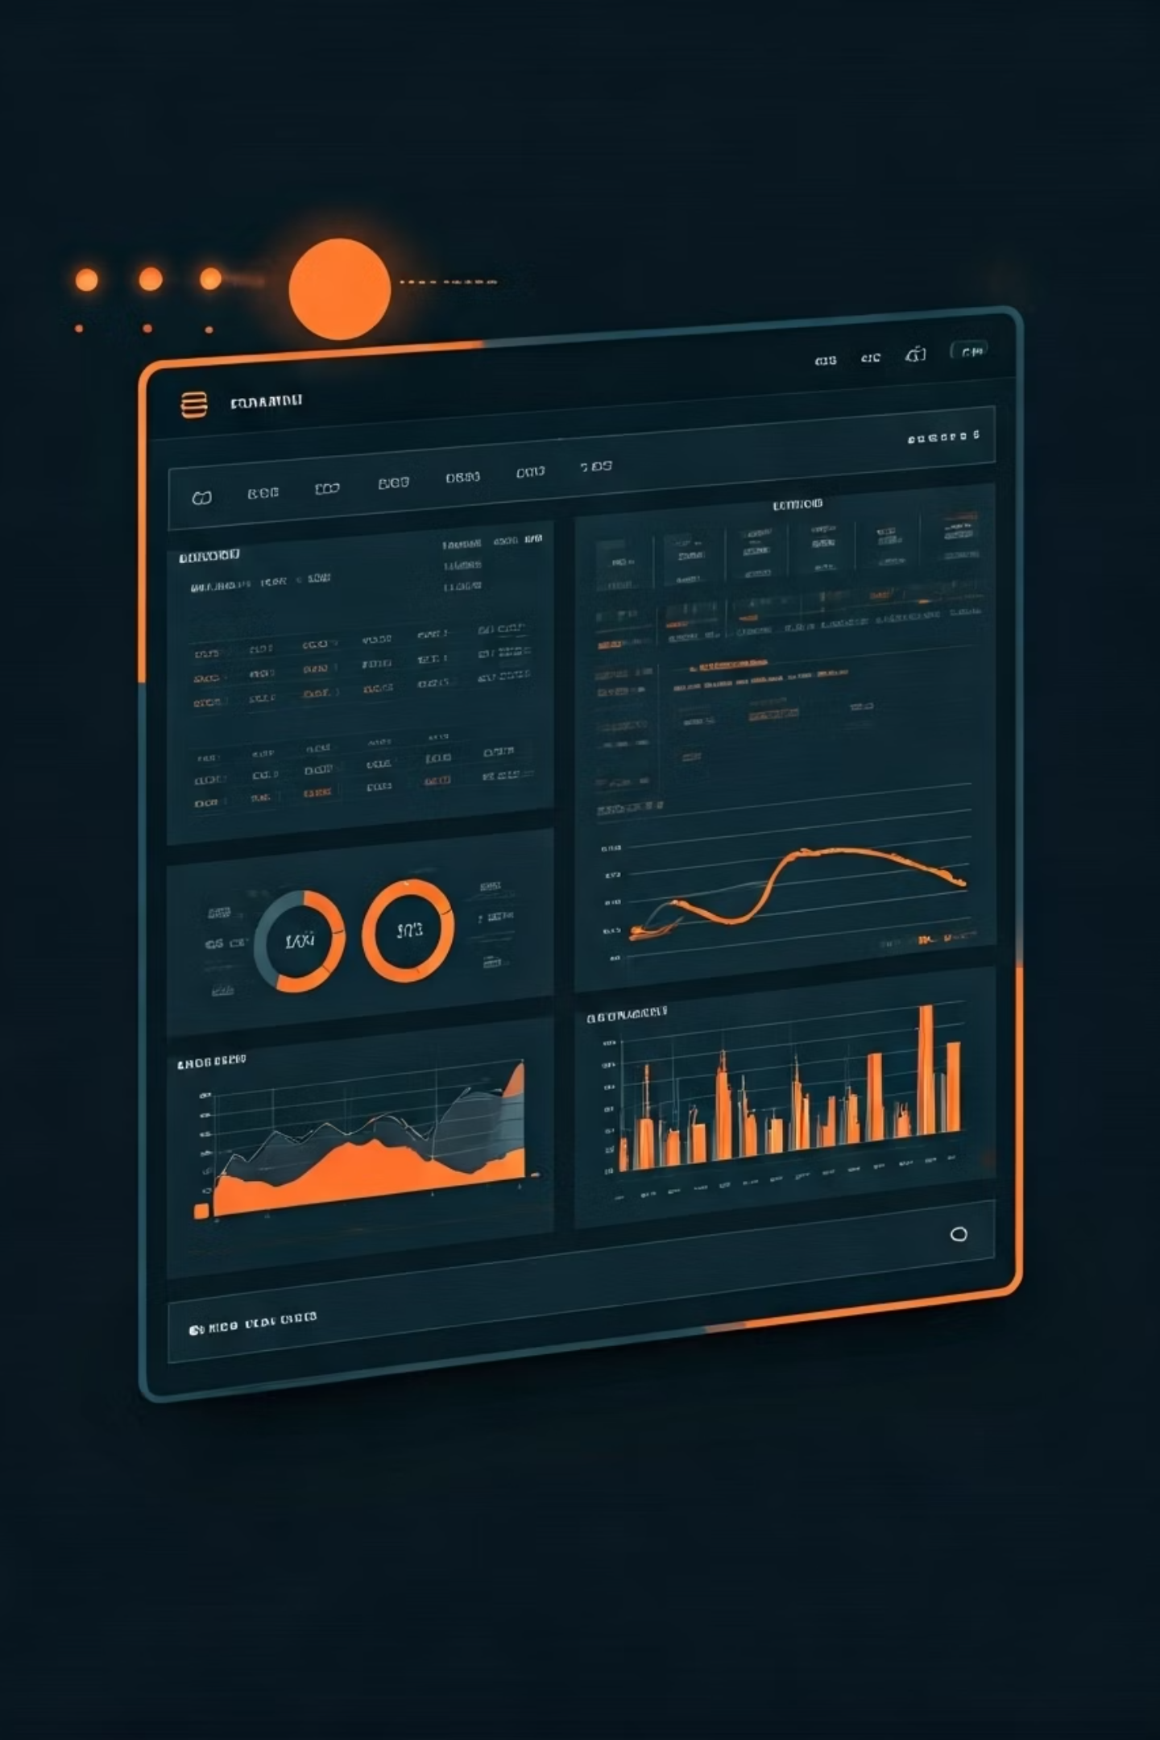
Power BI Dashboard
We developed an interactive Power BI dashboard designed for ease of use and boardroom readiness, providing dynamic insights into supermarket sales performance.
Interactive Filters
Key Performance Indicators
Enabled dynamic filtering by Region, City, Category, and Sub-Category.
Displayed crucial metrics: Sales, Profit, and Quantity.
Trendline Charts
Visualized sales patterns and future trajectories.

Slide 7

Key Insights
Our analysis revealed several critical insights that can drive strategic decisions for Supermart. Identifying profitable categories and understanding regional nuances are vital for optimizing business operations.
Most Profitable Categories Identified
Regional Trends Highlight Sales Variation
Pinpointed top-performing product categories for focused investment.
Uncovered significant differences in sales across various regions.
Forecast Model Aids in Stock Planning
Provided data-driven support for efficient inventory management.

Slide 8

Conclusion & Next Steps
We are pleased to report that all project tasks have been completed on time, with full version control maintained on GitHub. This project is now ready for final review and submission.
"All tasks completed on time, full GitHub version control maintained. Ready for final review and submission. Thank you!"

